Slide 1

Expense Income Tracker

Slide 2
MADE BY –
Ronak Agrawal (191500678)
Govind Singh (191500307)
Haresh Singh (191500311)
UNDER THE GUIDANCE OF –
Mr. Dipak Kumar Sah
(Assistant Professor)
Dept. of CEA, GLAU, Mathura

Slide 3
objectives
The primary objective of this project is to generate the report and expense card.
To create a website so that you can track your expenses anywhere, anytime.
To seamlessly manage your money and budget without any financial paperwork.
Access, submit, and approve invoices irrespective of time and location.
To get a detailed insight into the real-time income and expenditure.
Thus, you can plan your budget strategically to reduce unnecessary expenses.

Slide 4

Home Page

Slide 5
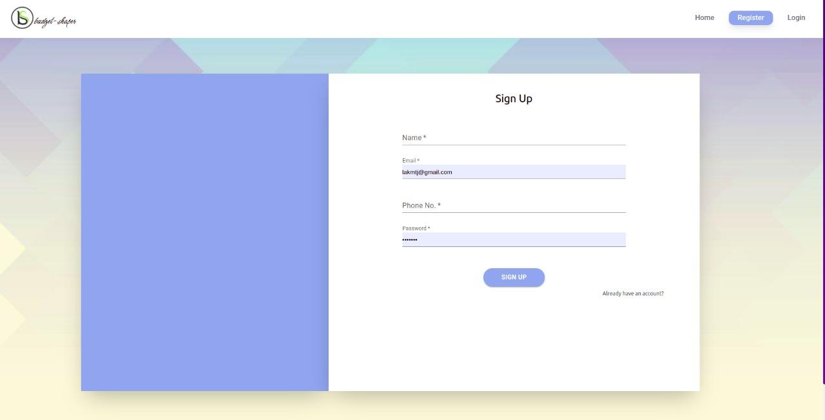
Register Page

Slide 6
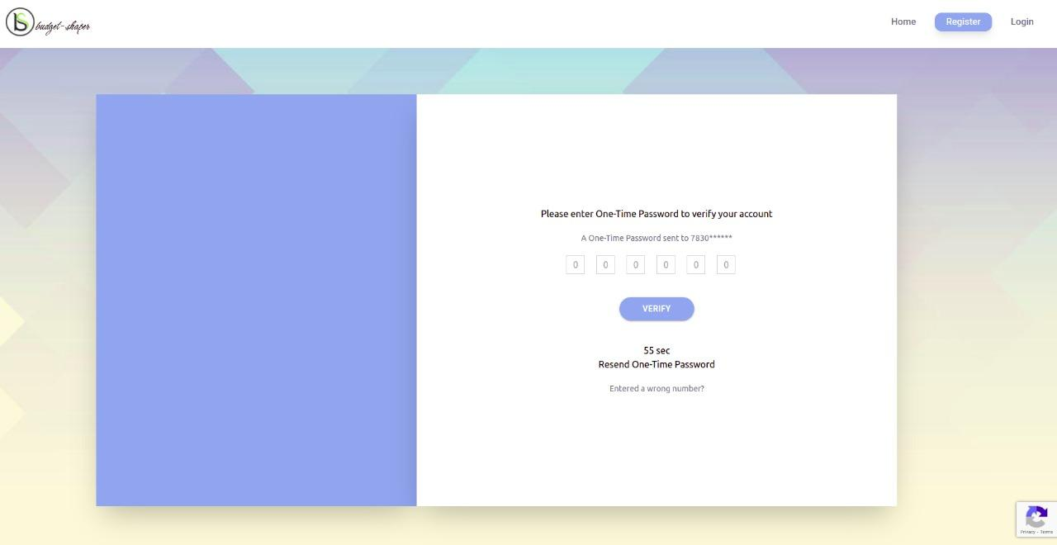
Verify Mobile Number After Registration

Slide 7
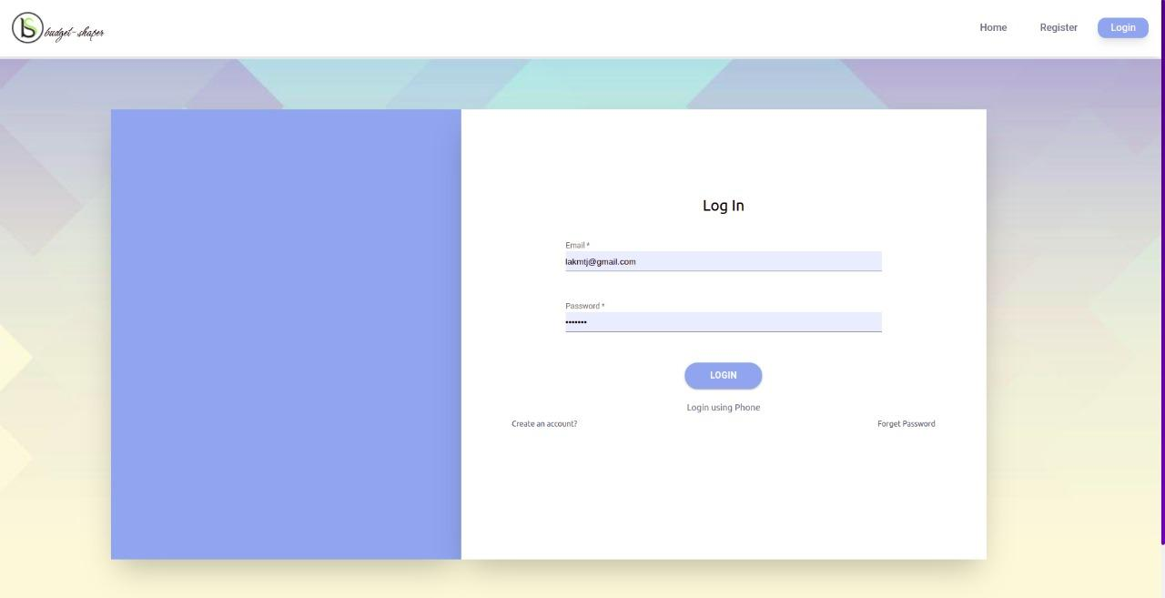
Login Page

Slide 8

Login Using Phone Number and OTP

Slide 9
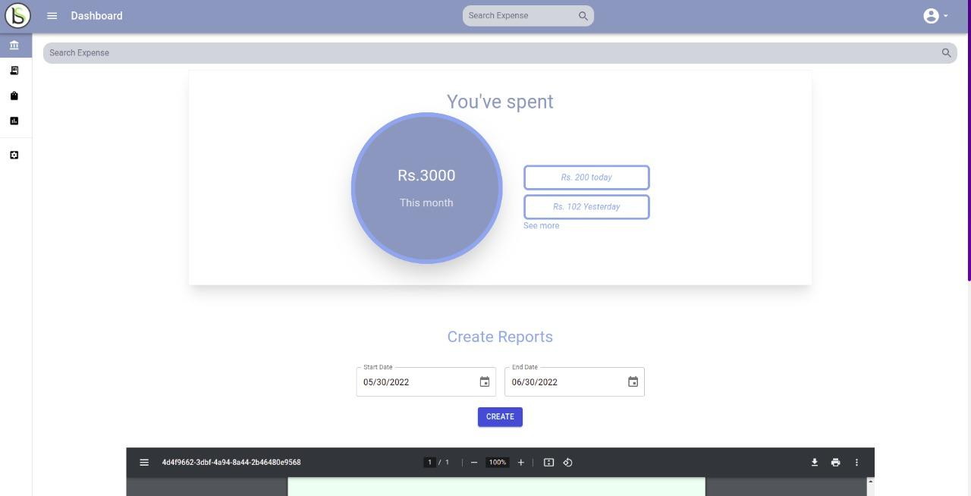
Dashboard Page After Login
Search expense from anywhere and go to expenses page

Slide 10
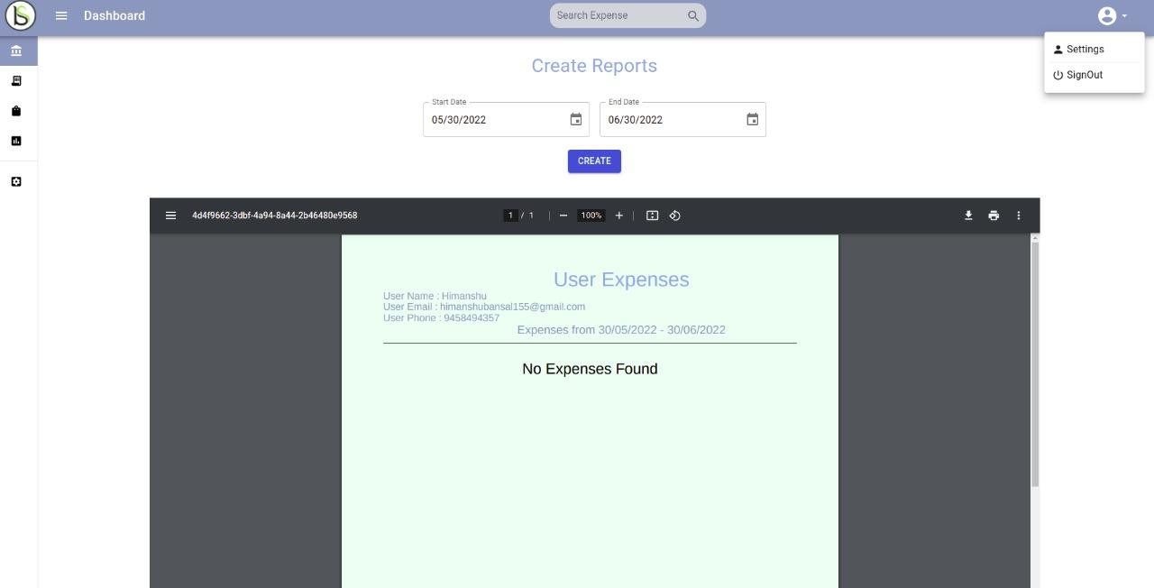
Create Reports for Expenses by filtering with dates
Sign out to logout user

Slide 11
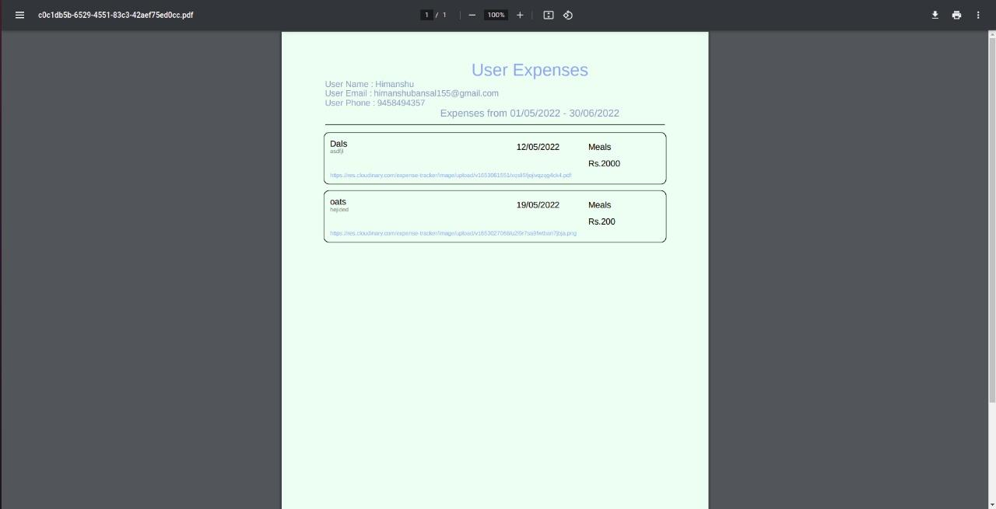
Downloaded pdf created from Dashboard

Slide 12
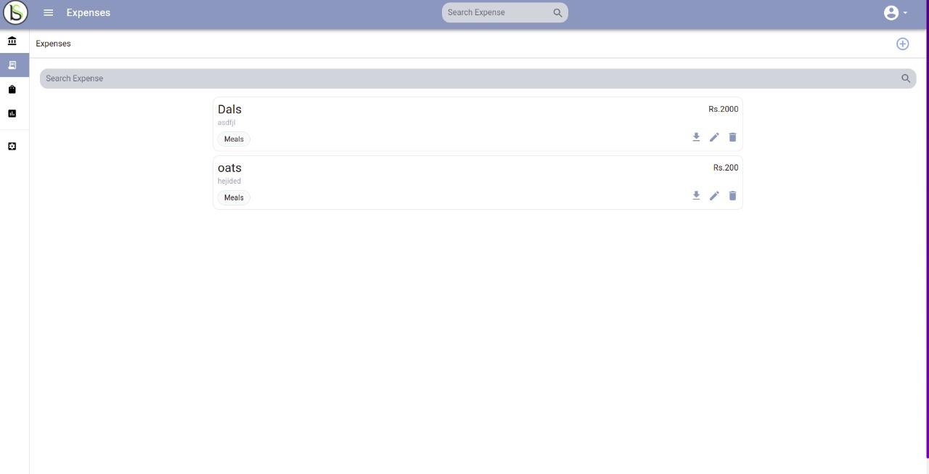
Expenses Page to Show All expenses

Slide 13
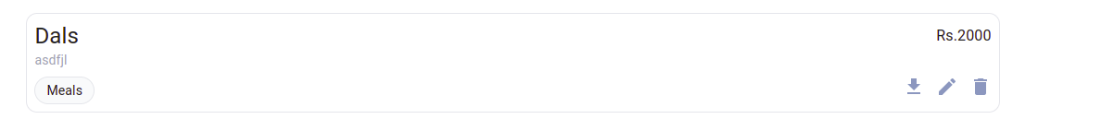
Expense Card
Title
Amount
Description
Category
Download Reciept
Delete Expense
Edit Expense

Slide 14
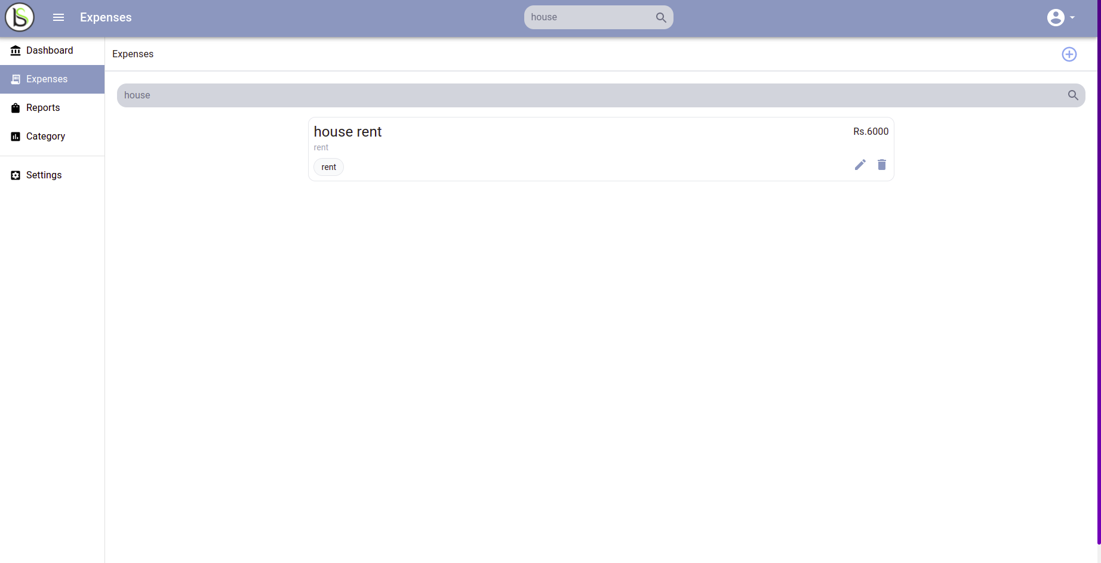
SideBar to open every page And Search Bar used to search expenses
Button to open and close sidebar
Text added to search expense by name

Slide 15
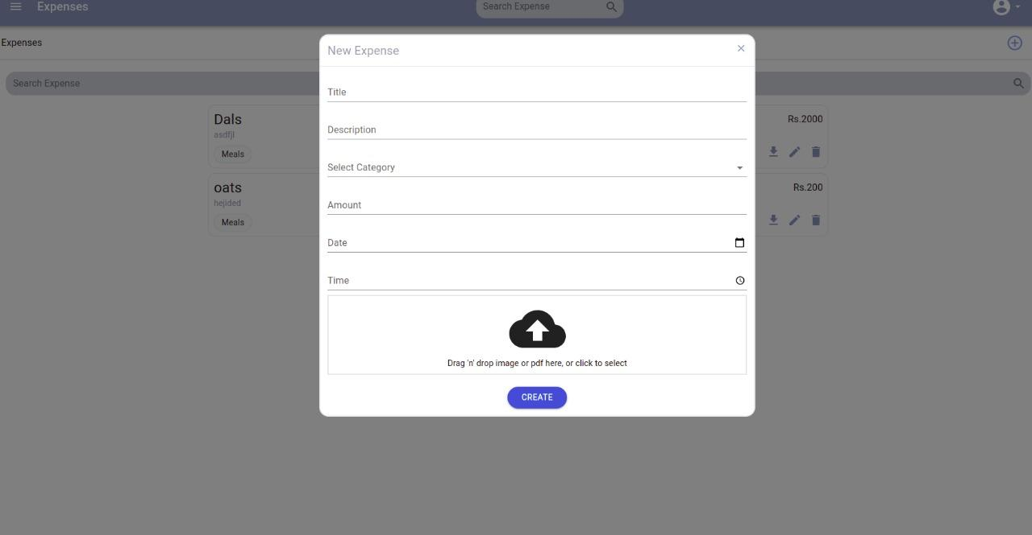
Create Expenses Modal and its button at expenses page

Slide 16


Loader used in app to show app Loading

Slide 17
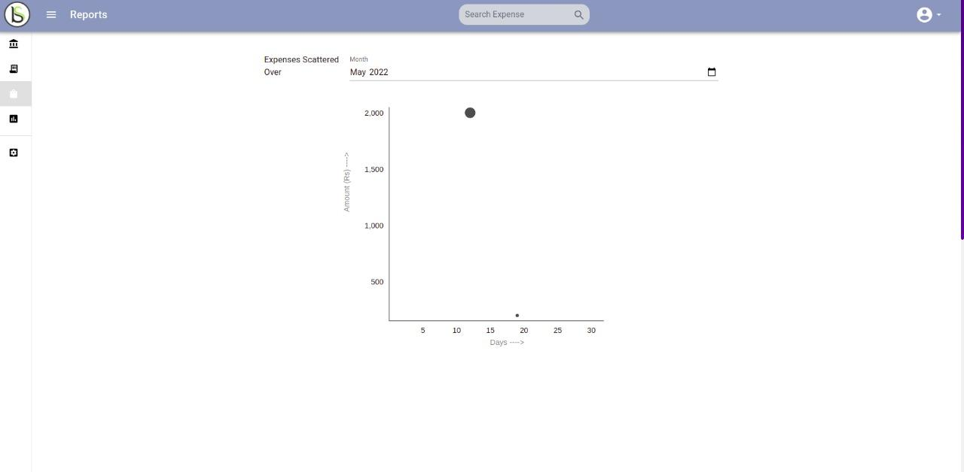
Expenses Plotted Using Per Month Filter
Picker to select month
Hover on dots to see expense details

Slide 18
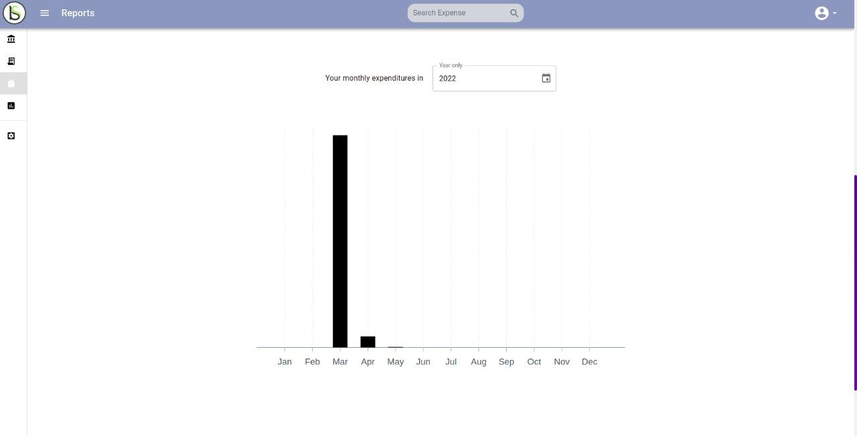
Get Your Total Month Expense Using Year filter
Picker to select year

Slide 19
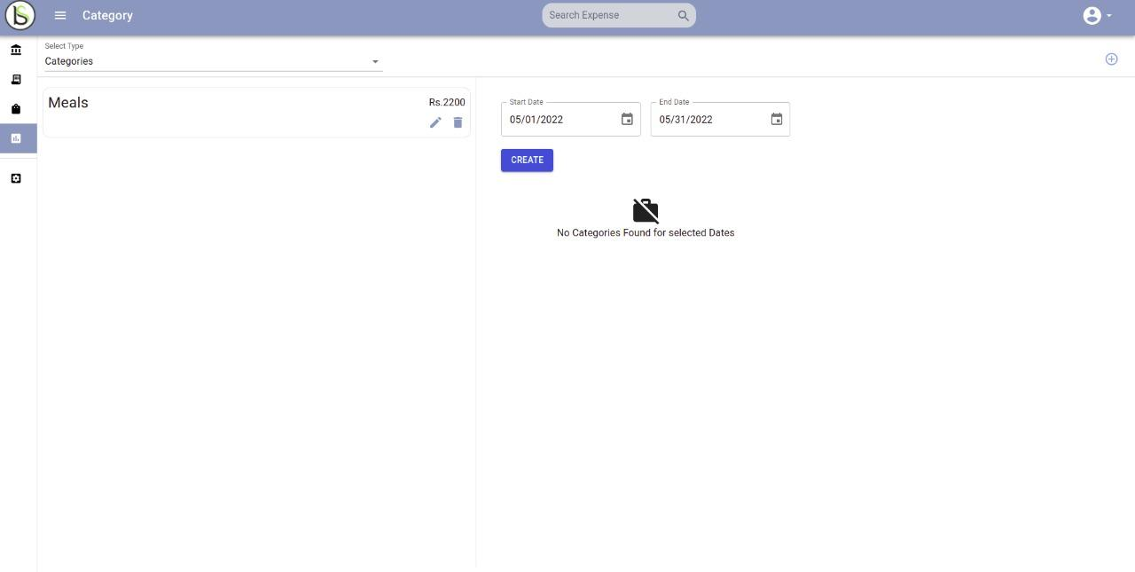
Categories Page to Show All Categories

Slide 20

Category Card
Title
Total Amount Spended by Category
Delete Category
Edit Category

Slide 21
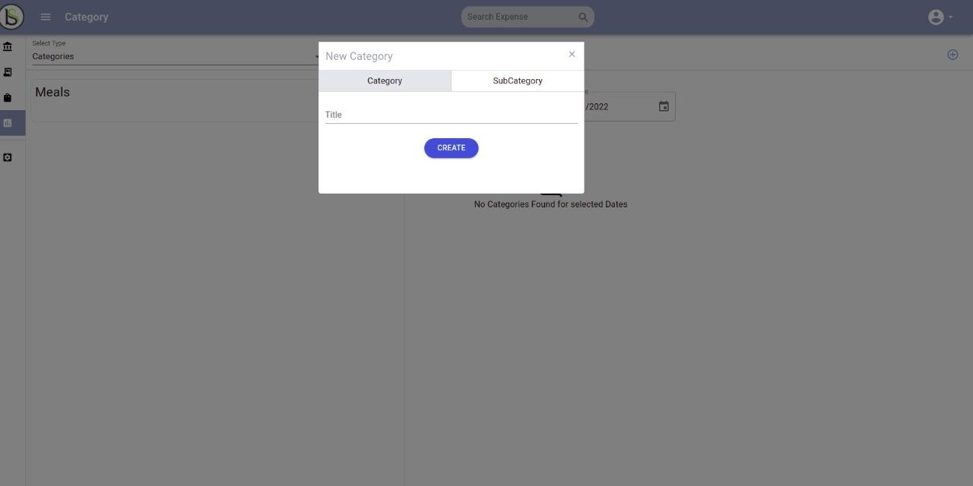
Modal to Create categories and subCategories
Button to create Category

Slide 22
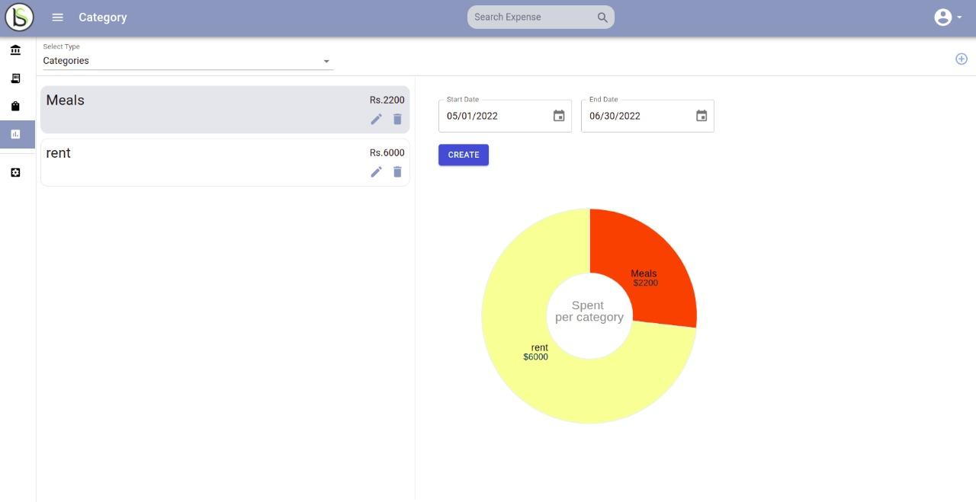
Pie Chart to show Total Amount Per Category
Filters to show categories between specific dates

Slide 23
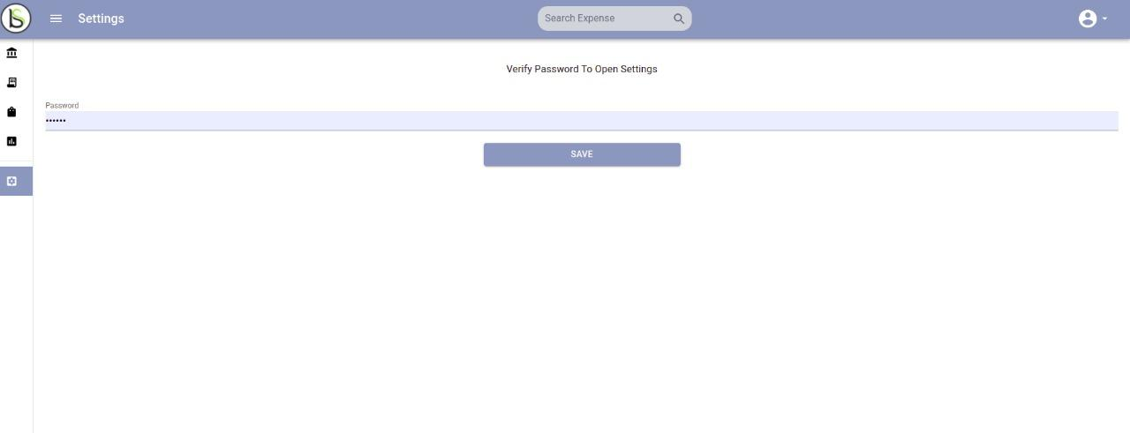
Settings page to Change User Profile
First Verify Your Password to change user fields
Click on save to move to next page

Slide 24
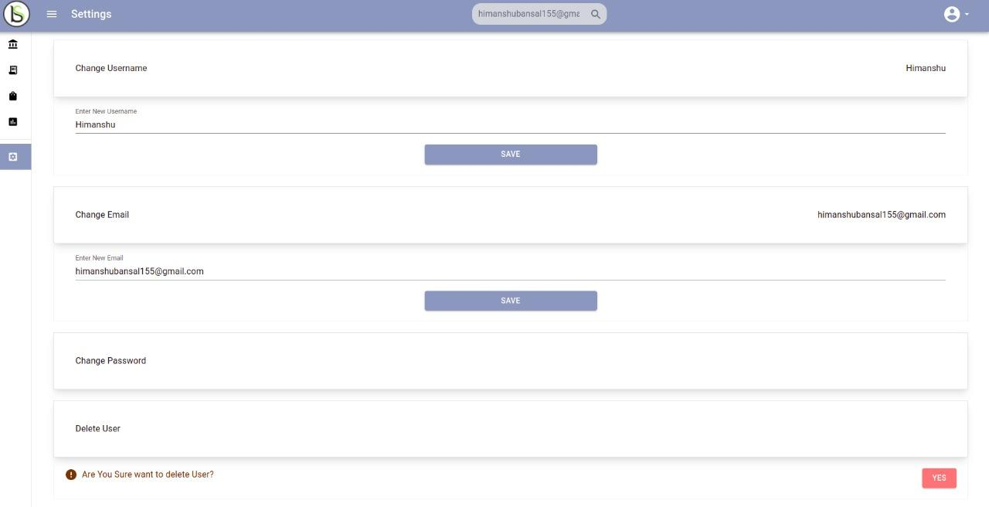
User Fields to change user details
Each Field has its own button to save specific details

Slide 25
CONCLUSION The project titled as “EXPENSE INCOME TRACKER” has been designed with much care, with the intension, easier and the more complexity and it is presented in a simple and lucid style. The advantage of this project is to easy and free way of making expense cards and reports. This project will provide a helping hand to the number of institutions during various assessments and analysis. “This project will define state repository in future for user access”

Slide 26
THANK YOU

